Slide 1
NP-Completeness Dr. Tathagata Ray Assistant Professor, BITS Pilani, Hyderabad Campus rayt@hyderabad.bits-pilani.ac.in

Slide 2
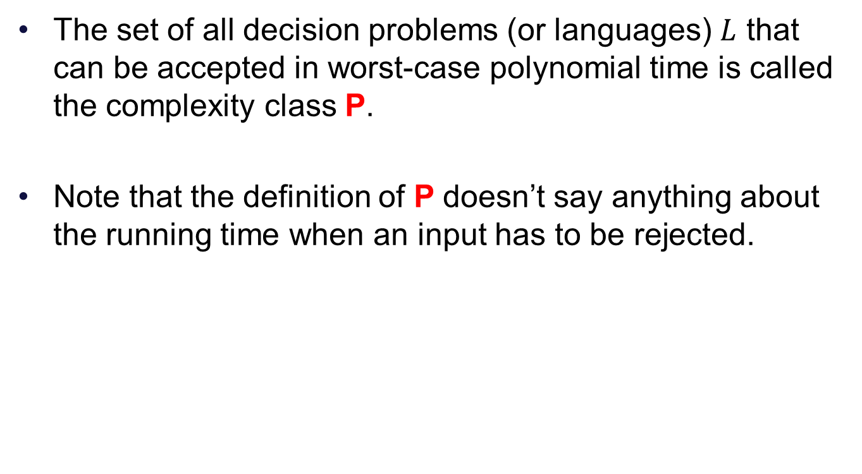
Complexity Class P
The set of all decision problems (or languages) $L$ that can be accepted in worst-case polynomial time is called the complexity class P.
Note that the definition of P doesn’t say anything about the running time when an input has to be rejected.

Slide 3
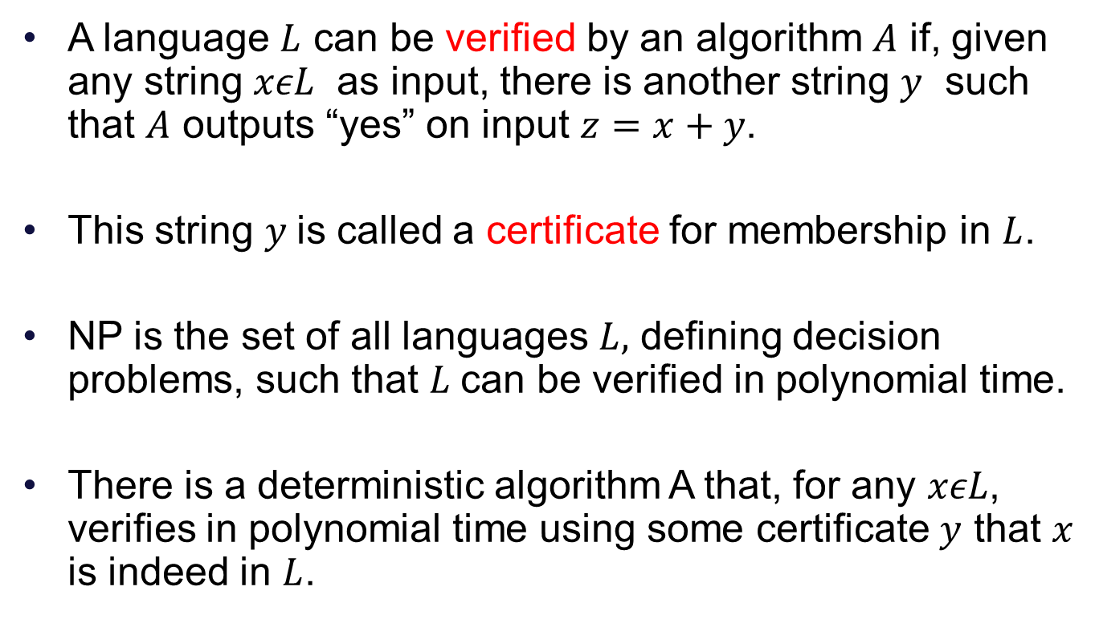
Complexity Class NP
A language $L$ can be verified by an algorithm $A$ if, given any string $xεL$ as input, there is another string $y$ such that $A$ outputs “yes” on input $z=x+y$.
This string $y$is called a certificate for membership in $L$.
NP is the set of all languages $L,$ defining decision problems, such that $L$can be verified in polynomial time.
There is a deterministic algorithm A that, for any $xεL$, verifies in polynomial time using some certificate $y$ that $x$ is indeed in $L$.

Slide 4
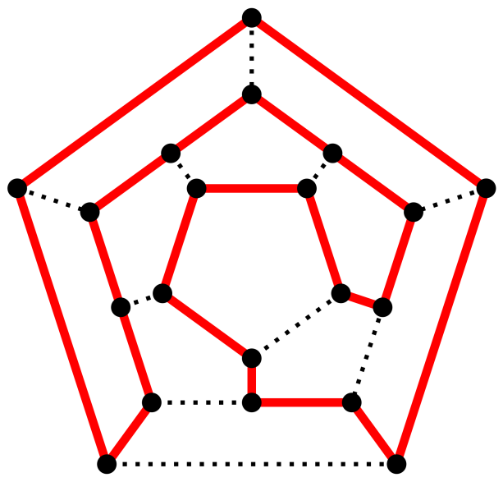

HAMILTONIAN CYCLE
HAM-CYCLE
Given an undirected graph $G(V,E)$, does there exist a
simple cycle $C$ that visits every node exactly once and returns to starting vertex?
"Hamiltonian path" by Christoph Sommer - Own work. Licensed under CC BY-SA 3.0 via Commons - https://commons.wikimedia.org/wiki/File:Hamiltonian_path.svg#/media/File:Hamiltonian_path.svg

Slide 5
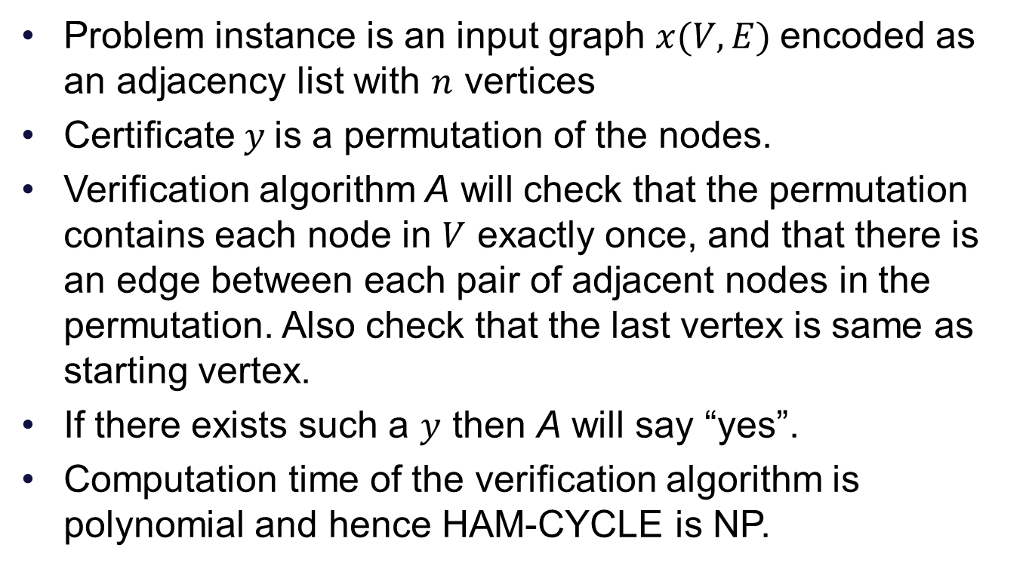
HAM-CYCLE is in NP
Problem instance is an input graph $x(V,E)$encoded as an adjacency list with $n$ vertices
Certificate $y$is a permutation of the nodes.
Verification algorithm A will check that the permutation contains each node in $V$ exactly once, and that there is an edge between each pair of adjacent nodes in the permutation. Also check that the last vertex is same as starting vertex.
If there exists such a $y$ then A will say “yes”.
Computation time of the verification algorithm is polynomial and hence HAM-CYCLE is NP.

Slide 6
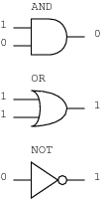
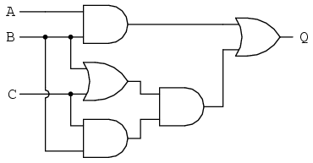
CIRCUIT-SAT
Given a Boolean circuit with a single output node, whether there is an assignment values to the circuit’s input so that its output value is “1”. Such an assignment of values is called as satisfying assignment.
http://www.ibiblio.org/kuphaldt/electricCircuits/Digital/04287.png

Slide 7
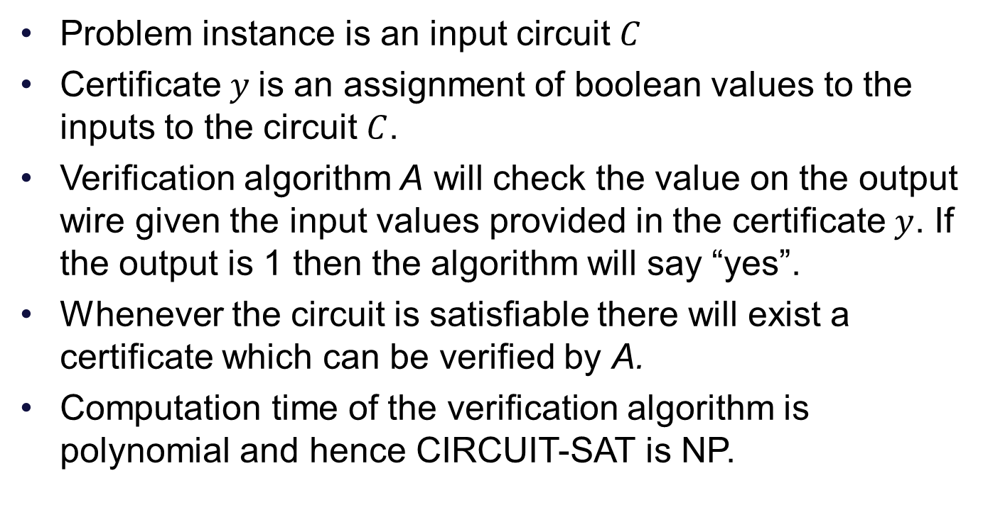
CIRCUIT-SAT is in NP
Problem instance is an input circuit $C$
Certificate $y$is an assignment of boolean values to the inputs to the circuit $C$.
Verification algorithm A will check the value on the output wire given the input values provided in the certificate $y$. If the output is 1 then the algorithm will say “yes”.
Whenever the circuit is satisfiable there will exist a certificate which can be verified by A.
Computation time of the verification algorithm is polynomial and hence CIRCUIT-SAT is NP.

Slide 8
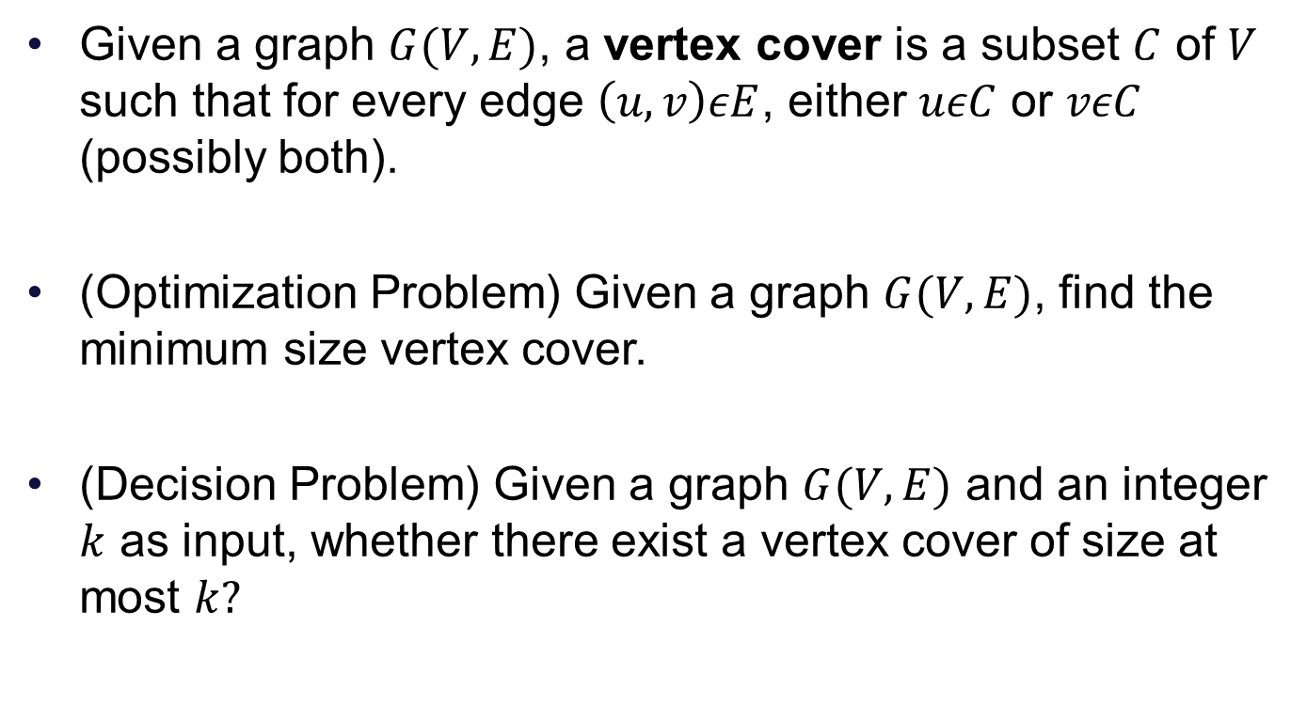
VERTEX COVER
Given a graph $G(V,E)$, a vertex cover is a subset $C$ of $V$ such that for every edge $\left(u,v\right)εE$, either $uεC$ or $vεC$ (possibly both).
(Optimization Problem) Given a graph $G(V,E)$, find the minimum size vertex cover.
(Decision Problem) Given a graph $G(V,E)$ and an integer $k$ as input, whether there exist a vertex cover of size at most $k?$

Slide 9
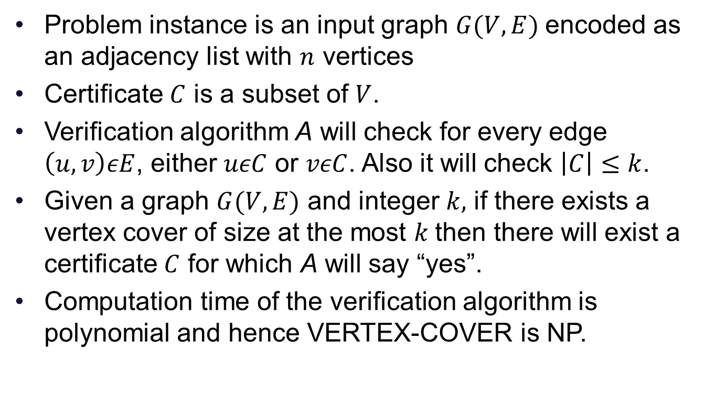
VERTEX-COVER is in NP
Problem instance is an input graph $G(V,E)$encoded as an adjacency list with $n$ vertices
Certificate $C$ is a subset of $V$.
Verification algorithm A will check for every edge $\left(u,v\right)εE$, either $uεC$ or $vεC$. Also it will check $\left|C\right|≤k$.
Given a graph $G(V,E)$ and integer $k,$ if there exists a vertex cover of size at the most $k$then there will exist a certificate $C$ for which A will say “yes”.
Computation time of the verification algorithm is polynomial and hence VERTEX-COVER is NP.

